Slide 1
Earthquake Prediction Analysis
MIS 637-WS Data Analytics and Machine Learning
Group #3
Komal Wavhal
Jyotiraditya Singh
Preeti Sanjay Chougule
Samiksha Sunil Dhemse

Slide 2





Team Members
Jyotiraditya Singh
CWID: 20033268
Preeti Sanjay Chougule
CWID: 20027873
Samiksha Sunil Dhemse
CWID:20034039
Komal Wavhal
CWID: 20034443

Slide 3
Agenda
 |  | 1. | Introduction & Problem Statement
 |  | 2. | Project Process Flow
 |  | 3. | Dataset, Algorithms, Software/Tools
 |  | 4. | Key Features
 |  | 5. | Data Cleaning & Pre-processing
 |  | 6. | Exploratory Data Analysis
 |  | 7. | Planned Deployment
 |  | 8. | Conclusion and Future Work
 |  | 9. | References

Slide 4
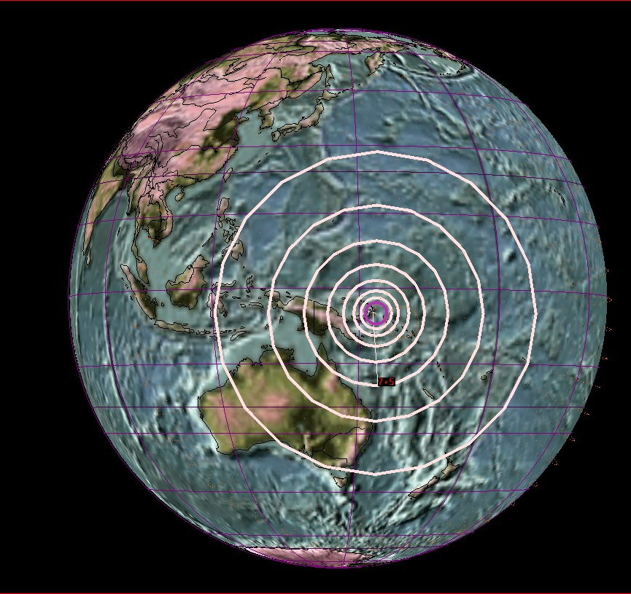
Business Understanding
Objective: To develop a machine learning-based model that predicts the likelihood of earthquakes using historical seismic data from the USGS Earthquake Hazards Program.
Goal :
Enhance early warning systems, improve disaster preparedness, and minimize human and economic losses by identifying high-risk zones through predictive modeling.
Importance:
Earthquakes pose significant risks, and timely prediction of their magnitudes is crucial for mitigating their impact on communities. Machine learning offers advanced predictive capabilities that can improve early warning systems and disaster response planning.

Slide 5

Introduction & Problem Statement
Introduction:
Earthquakes pose a major threat to human life, infrastructure, and economies across the world. Despite significant advancements in Earth science, accurately predicting seismic events remains a complex challenge due to the unpredictability of natural phenomena. This project aims to develop a machine learning-based predictive model that forecasts the likelihood of earthquakes based on historical seismic data. By leveraging data from the USGS Earthquake Hazards Program, the model will analyze patterns related to geographical location, magnitude, depth, and temporal factors. The ultimate goal is to enhance earthquake hazard assessment, improve early warning systems, and contribute to disaster preparedness efforts. Accurate earthquake prediction models have the potential to inform government agencies, businesses, and the public, enabling proactive measures to save lives, minimize economic losses, and build resilient communities.
Problem Statement:
The goal of this project is to build a machine learning model that can predict the likelihood of earthquake occurrences based on historical seismic data. By focusing on geographical location, magnitude, and time, the model aims to support early warning systems and improve disaster preparedness by identifying high-risk zones in advance.

Slide 6
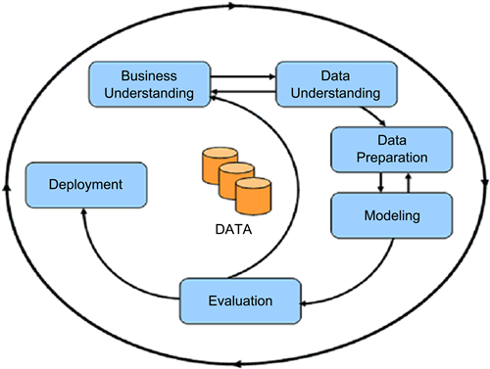
CRISP – DM Phase
1. Business Understanding: Focuses on understanding the project objectives and requirements from a business perspective.
Define business objectives, assess the situation, determine data mining goals, and create a project plan.
2. Data Understanding: Involves collecting initial data and familiarizing yourself with it.
Data collection, data description, data exploration, and data quality verification.
3. Data Preparation: The most time-consuming phase; involves cleaning and transforming raw data into a suitable format.
Selecting relevant data, cleaning, constructing new variables, integrating data, and formatting.
4. Modeling: Use statistical or machine learning algorithms to build predictive or descriptive models.
Selecting modeling techniques, testing model assumptions, and building and assessing models.
5. Evaluation: Assess the models to ensure they meet business objectives.
Evaluate results, review the process, and determine next steps.
6. Deployment: Implement the model or insights into the business process.
Plan deployment, monitor and maintain, produce final reports, and review the project.
Cross-Industry Standard Process for Data Mining

Slide 7


Project Process Flow
Model Selections
Problem Definition
Data Load
Data Cleaning & Pre-processing
Exploratory Data Analysis
Model Training
USGS Earthquake Hazards Program
Model Prediction
Future Scope
Model Deployment
Hyperparameter Tuning
Model Evaluation

Slide 8
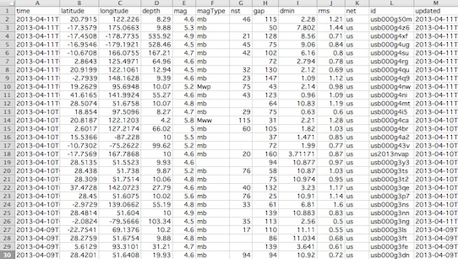
Dataset, Algorithms and Software/Tools
Dataset - USGS Earthquake Hazards Program
The dataset used in this project is sourced from the USGS Earthquake Hazards Program. It includes crucial variables such as time, latitude and longitude of the earthquake epicenter, depth, magnitude, location description, and various other seismic-related attributes.
Algorithms:
- Decision Tree Regressor
- K-Nearest Neighbors (KNN) Regressor
Software/Tools Used:
Programming Language: Python
Libraries: Scikit-learn, Pandas, NumPy, Plotly Express for visualization
Environment: Jupyter Notebook/Google Colab
https://earthquake.usgs.gov/earthquakes/feed/v1.0/csv.php

Slide 9
Data Understanding
Features/Fields
time | rms
latitude | net
longitude | id
depth | updated
mag | place
magType | type
nst | locationSource
gap | magSource
dmin | horizontalError
magnNst | depthError
status | magError
Source: USGS Earthquake Hazards Program
Link: https://earthquake.usgs.gov/earthquakes/feed/v1.0/csv.php
Key Features:
Temporal: Time, Updated
Geographical: Latitude, Longitude, Place
Seismic Properties: Depth, Magnitude, MagType, RMS, Dmin, Gap
Quality Metrics: HorizontalError, DepthError, MagError
Meta: ID, Type, Status, MagNst, LocationSource, MagSource

Slide 10
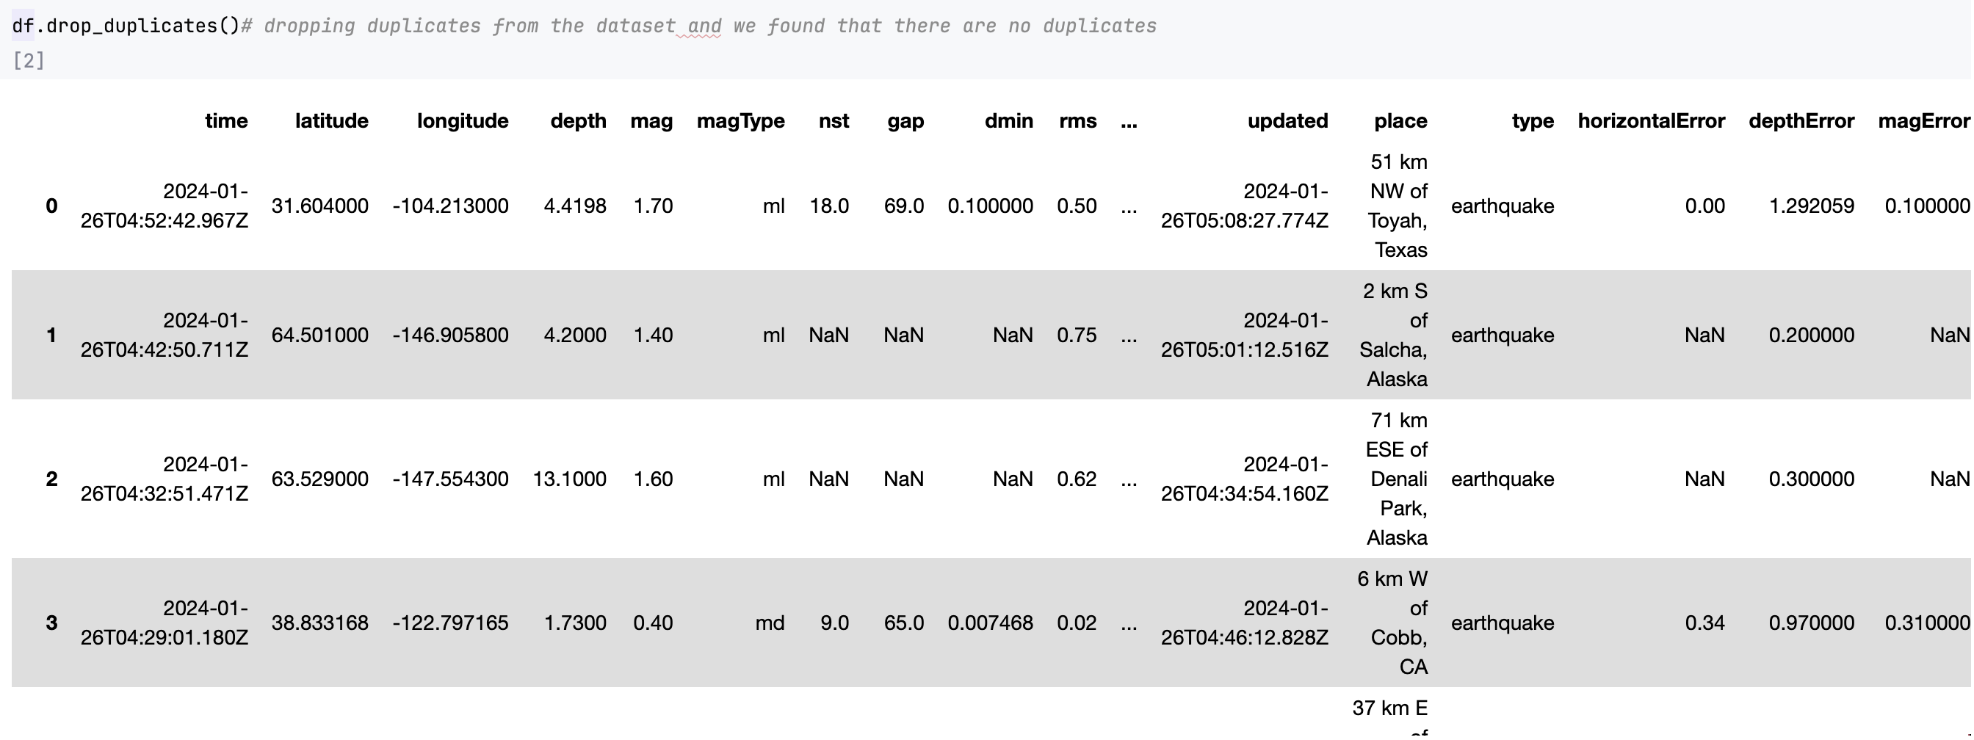
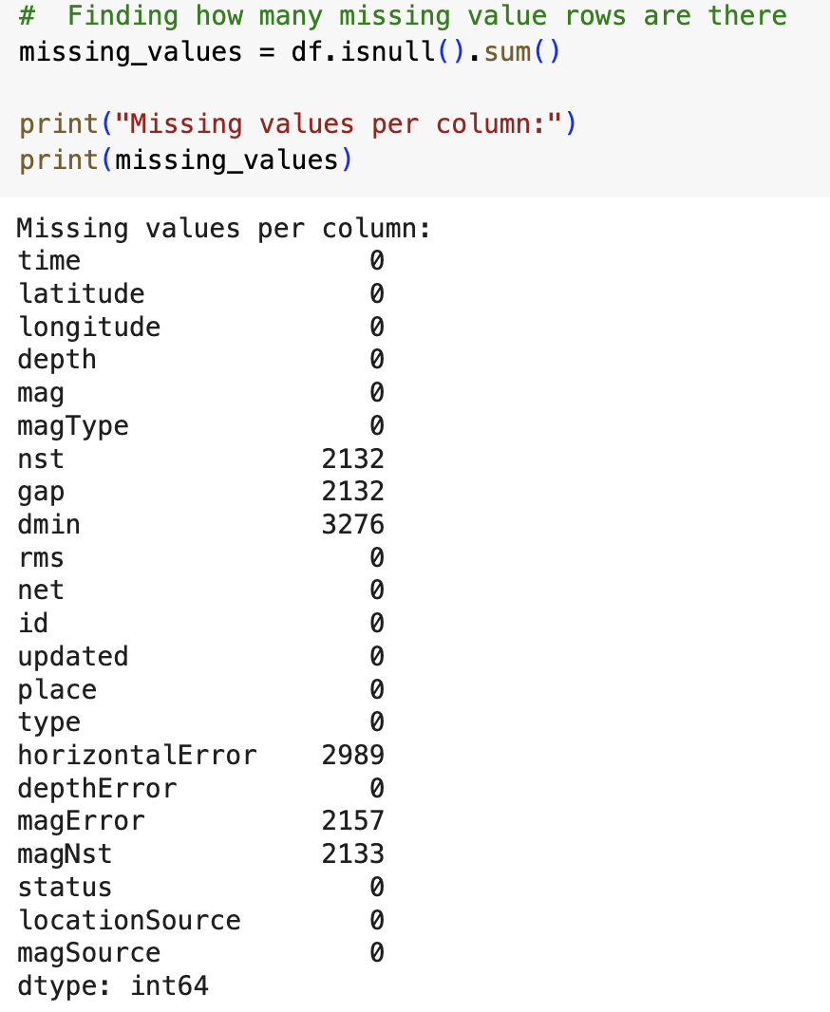
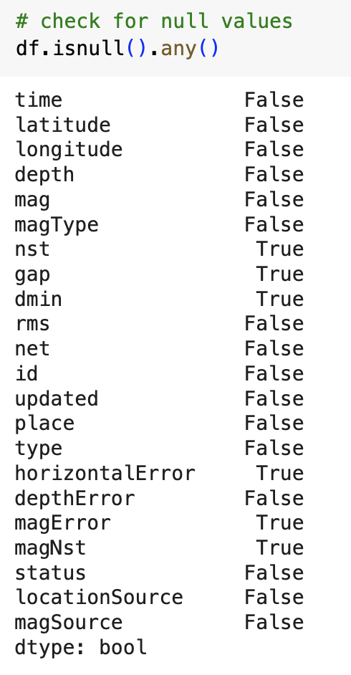
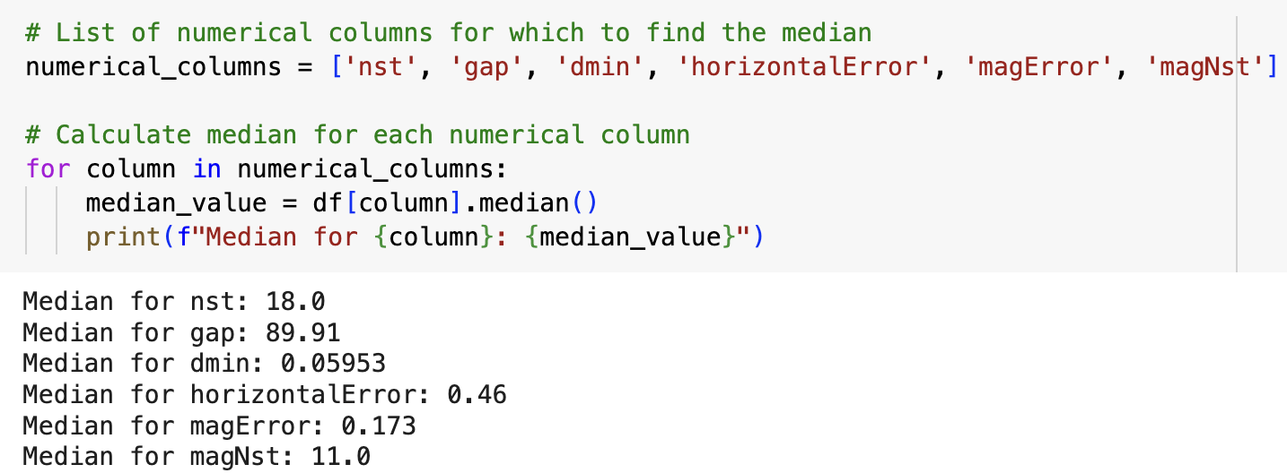
Data Understanding

Slide 11
Key Features:
Variables | Description
Time | Timestamp of the earthquake event
Latitude and Longitude | Geographical coordinates of the earthquake epicenter
Depth | Depth of the earthquake in kilometers
Magnitude (Mag) | Magnitude of the earthquake event
Magnitude Type (MagType) | Method used to calculate the earthquake magnitude
Network Stations (NST) | Total number of seismic stations
Azimuthal Gap (Gap) | Largest azimuthal gap between adjacent seismic stations
Horizontal Distance (Dmin) | Horizontal distance from the epicenter to the nearest station
Root-Mean-Square (RMS) | RMS travel time residual in seconds
Earthquake ID (ID) | Unique identifier for each earthquake event
Variables | Description
Updated Time (Updated) | Timestamp of the last update
Location Description (Place) | Geographic region near the earthquake event
Earthquake Type (Type) | Type of seismic event
HorizontalError(HorizontalError) | Uncertainty in location in kilometers
Depth Error (DepthError) | Uncertainty in reported depth in kilometers
Magnitude Error (MagError) | Uncertainty in reported magnitude
Magnitude Stations (MagNst) | Total number of seismic stations
Event Status (Status) | Review status indicating human review
Location Source (LocationSource) | Network providing reported location
Magnitude Source (MagSource) | Network providing reported magnitude

Slide 12

Data Cleaning & Pre-Processing
Handling Missing Values
Removal of duplicate entries .
Outlier detection using using z-score and standard deviation methods
Data Type: All were numerical data types (float64) bit. No Categorical data types present.
Feature scaling (using Min-Max scaling or Standardization).

Slide 13
Data Cleaning
Duplicate Removal: The dataset was checked for duplicate entries, and it was found that there were no duplicate rows, ensuring data integrity and accuracy.
Handling Missing Values: Identified missing values in certain columns such as 'nst', 'gap', 'dmin', 'horizontalError', 'magError', and 'magNst'. These missing values were addressed by filling them with the respective median values for each column.
Data Quality Assurance: Ensuring data quality and consistency by handling missing values appropriately, which is crucial for building reliable predictive models.
Outliers Detection
Z-Score Method: Calculated z-scores for numerical columns to detect outliers based on their standard deviations from the mean. Identified outliers can significantly impact model performance and were addressed to improve the accuracy of predictions.
Outliers Handling: Outliers identified using the z-score method were either removed or transformed to mitigate their influence on the models' training and predictions.
Normalization
MinMaxScaler: Utilized MinMaxScaler from the sklearn library to normalize numerical columns such as 'latitude', 'longitude', 'depth', 'nst', 'gap', 'dmin', 'rms', 'horizontalError', 'depthError', 'magError', and 'magNst'. Normalization brings all numerical features to a similar scale, which aids in better model convergence and performance.
Scaling Numerical Features: Normalization ensures that numerical features are within a consistent range, preventing certain features from dominating others during model training and improving overall model effectiveness.

Slide 14
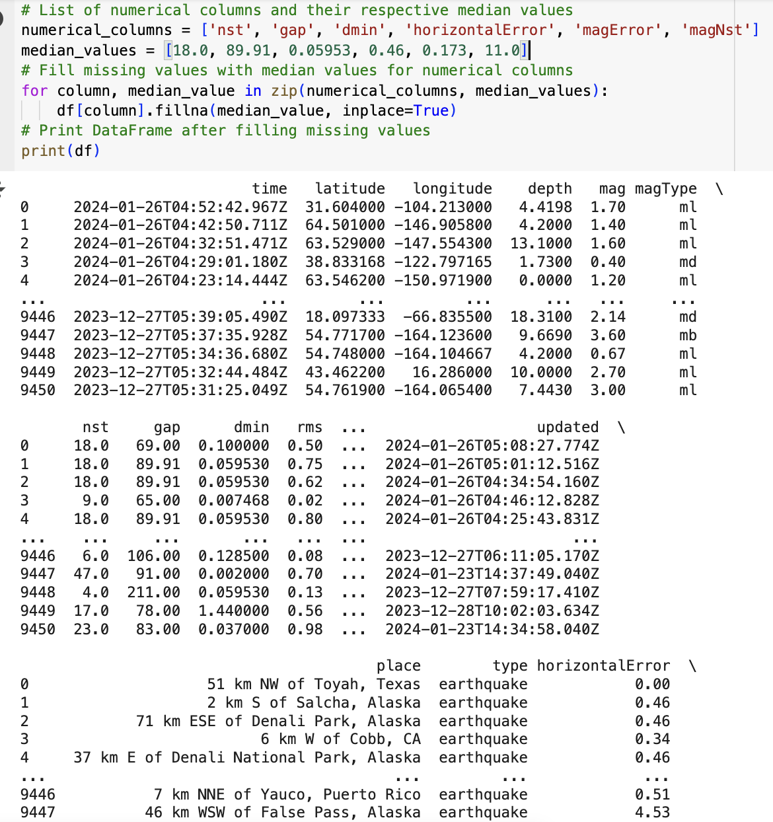
Data Cleaning & Pre-Processing

Slide 15
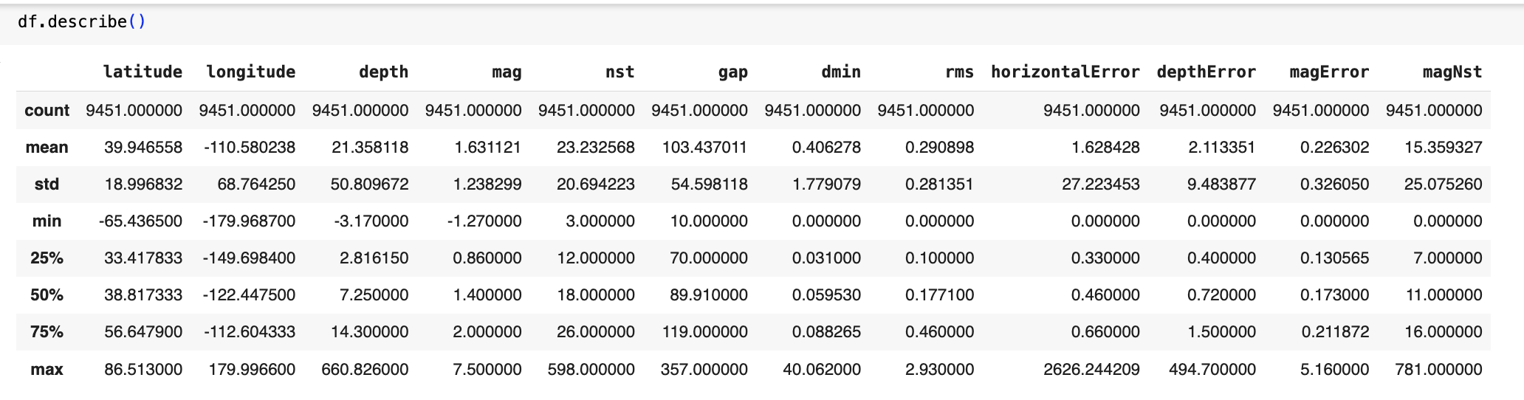
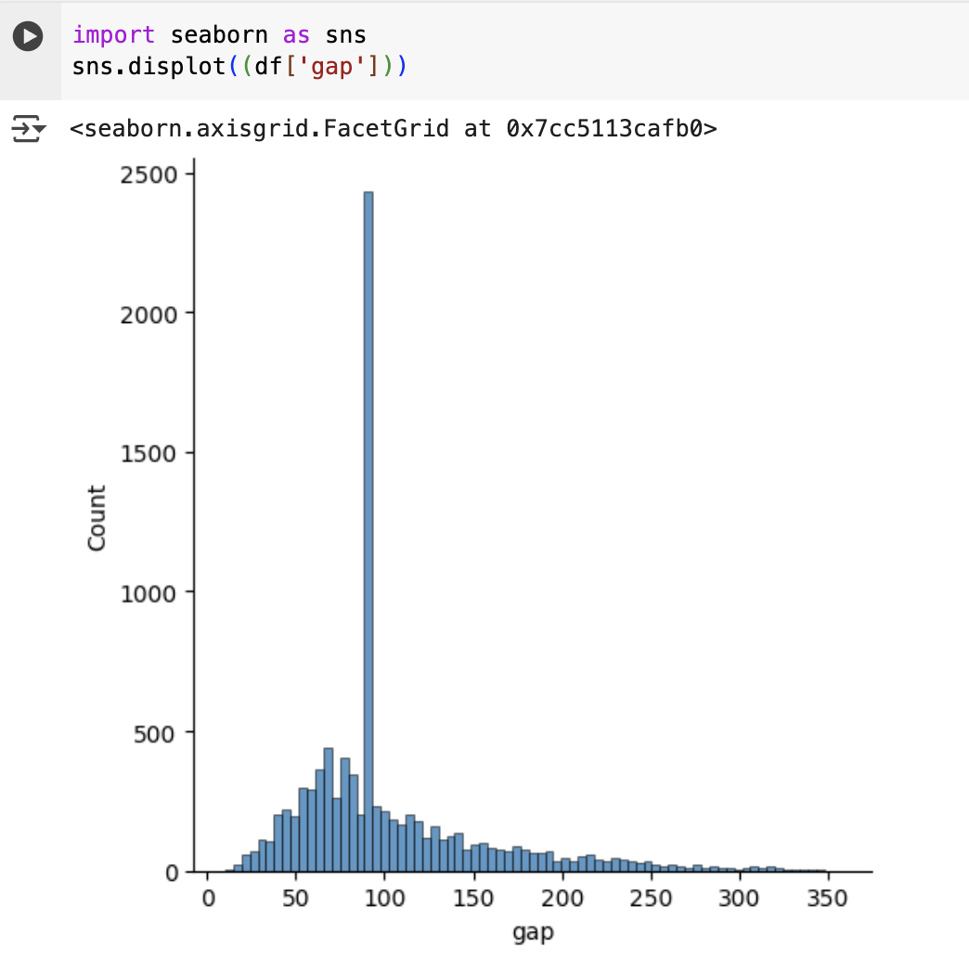

Slide 16
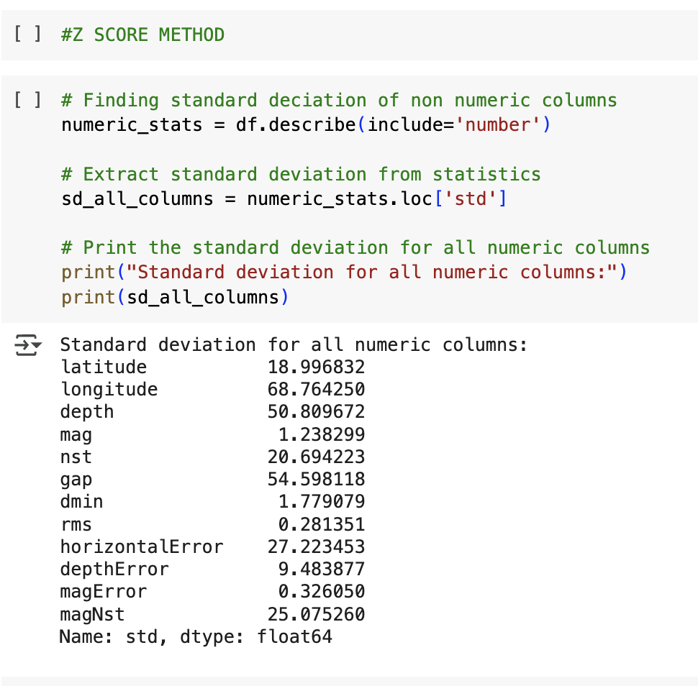

Slide 17

Exploratory Data Analysis
We will analyze the USGS Earthquake Hazards dataset to understand key features like time, latitude, longitude, depth, and magnitude. We examined the data for missing values, outliers, and trends in earthquake occurrences over time and across regions. Visualizations helped identify patterns, hotspots, and any data inconsistencies, ensuring the dataset was ready for building accurate predictive models.
Exploratory Data Analysis

Slide 18
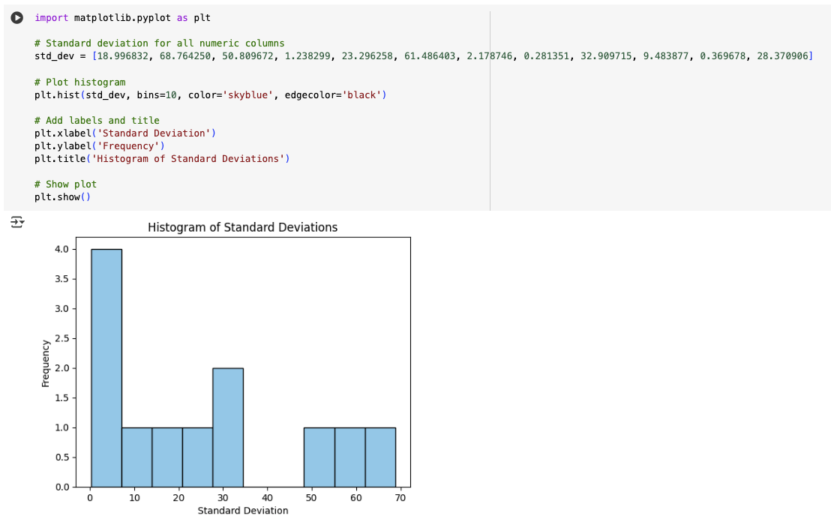
Exploratory Data Analysis

Slide 19
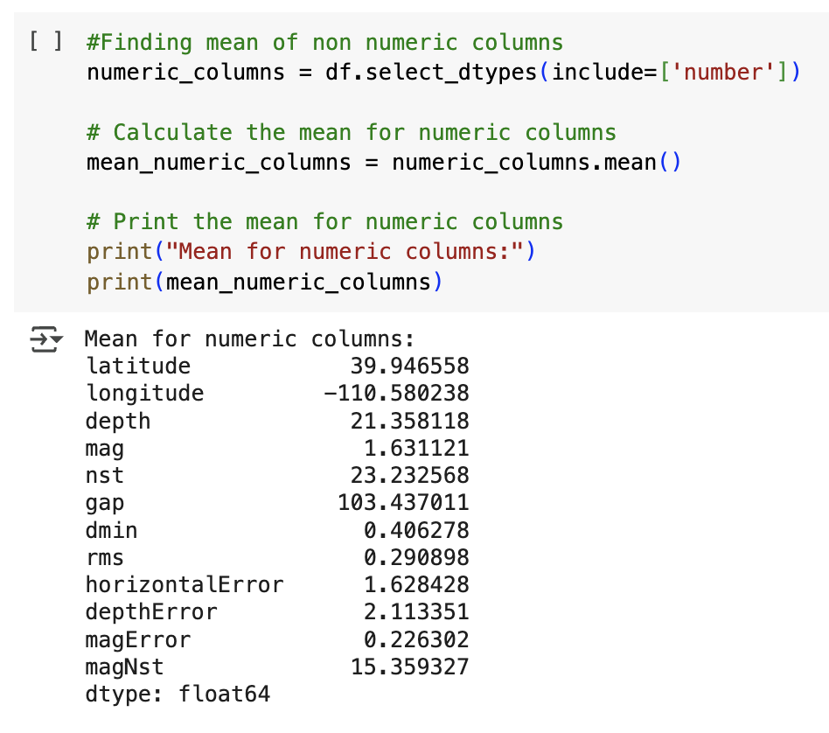
Exploratory Data Analysis

Slide 20
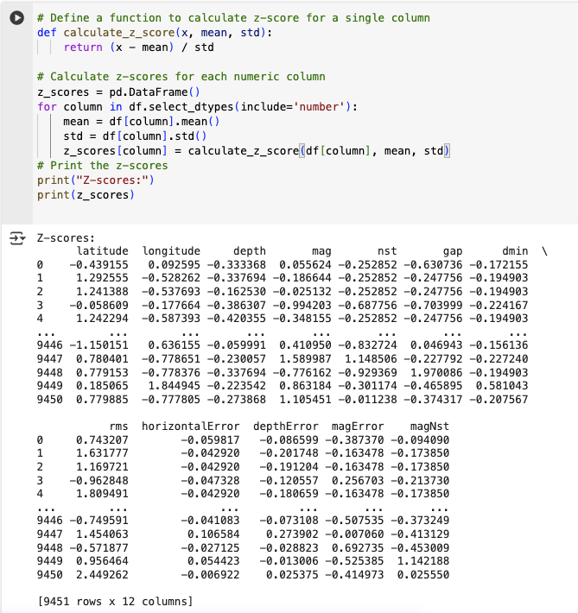
Exploratory Data Analysis

Slide 21
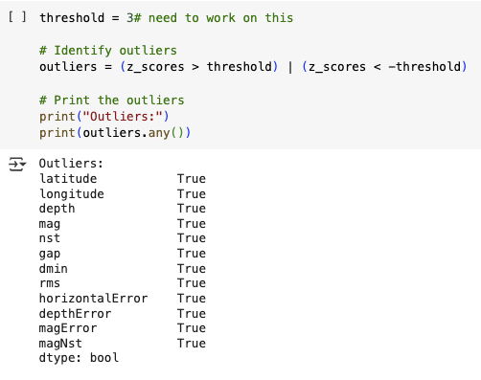
Exploratory Data Analysis

Slide 22
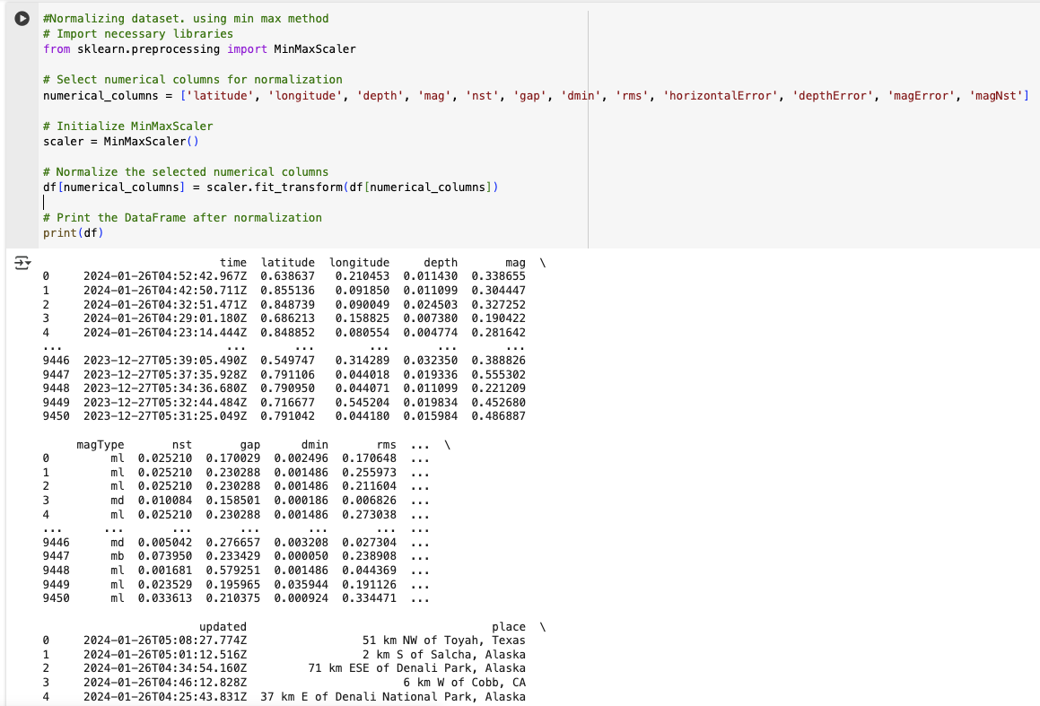
Exploratory Data Analysis

Slide 23
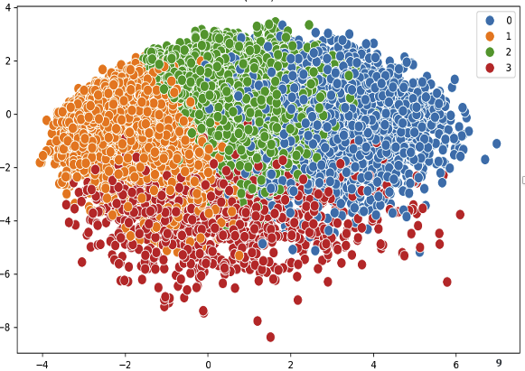
Exploratory Data Analysis
K-Nearest Neighbors (KNN) Model Overview
Evaluation Metrics:
Mean Squared Error (MSE)
Decision Tree:
KNN:
R-squared (Accuracy)
Decision Tree:
KNN:

Slide 24
K-Nearest Neighbors (KNN)
Implementing two regression models, namely K-Nearest Neighbors (KNN) Regressor and Decision Tree Regressor, to predict earthquake magnitudes based on historical data and features like depth, location, and seismic parameters.
Model Training: Splitting the data into training and testing sets, training the models on the training data, and evaluating their performance using metrics like Mean Squared Error (MSE) and R-squared (Coefficient of Determination).
KNN Regression is a non-parametric machine learning algorithm used for regression tasks. It predicts the value of a target variable by averaging the values of the 'k' nearest data points in the training set to the query point.
KNN is simple to understand and implement, making it suitable for introductory machine learning tasks. It can capture complex relationships in the data without making strong assumptions about the underlying distribution. Additionally, it can handle both regression and classification tasks.

Slide 25
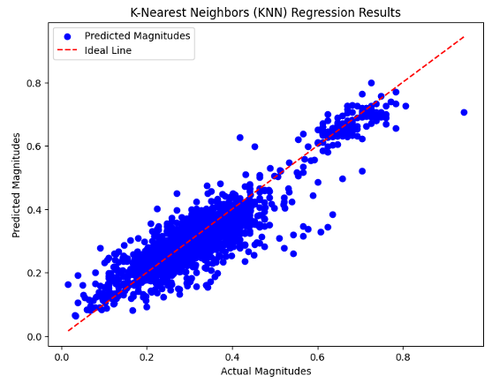
KNN
Model Training:
Split the data into training and testing sets.
Initialize the KNN regressor with a specified number of neighbors ('k’).
Fit the regressor to the training data, where it learns the patterns in the feature space.
Predictions:
After training, the KNN regressor predicts earthquake magnitudes on the test data by finding the 'k' nearest neighbors for each data point.
It calculates the average of the target magnitude values of these neighbors as the predicted magnitude.
Evaluation Metrics:
Mean Squared Error (MSE): The KNN Regressor achieved an MSE of approximately 0.00289, indicating a low average squared difference between actual and predicted earthquake magnitudes.
R-squared (Accuracy): The KNN Regressor achieved an R-squared value of about 0.8483, indicating that approximately 84.83% of the variance in earthquake magnitudes is predictable from the independent variables.

Slide 26
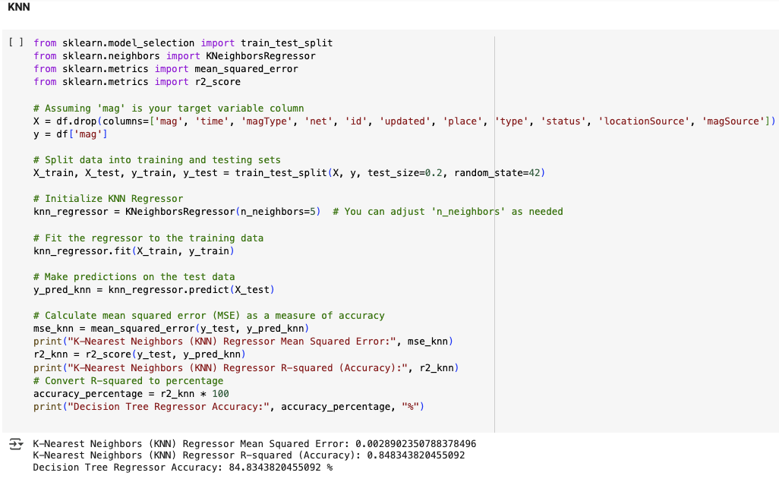

Slide 27
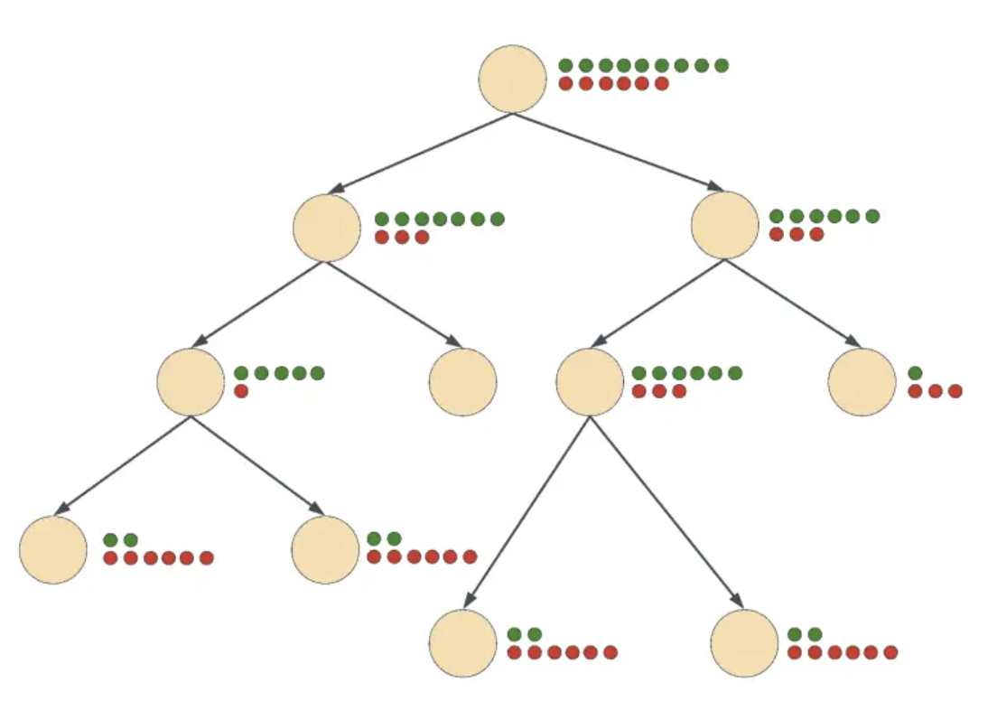
Decision Tree Regression
Decision Tree is a tree-like structure where nodes represent features, branches represent decisions, and leaf nodes represent outcomes. It's used for regression tasks and efficiently handles large datasets.
Decision Trees are easy to interpret and visualize, making them valuable for understanding feature importance and decision rules. They can handle both numerical and categorical data and are robust to outliers. Decision Trees can also handle complex relationships in the data.
Fig. Decision Tree

Slide 28
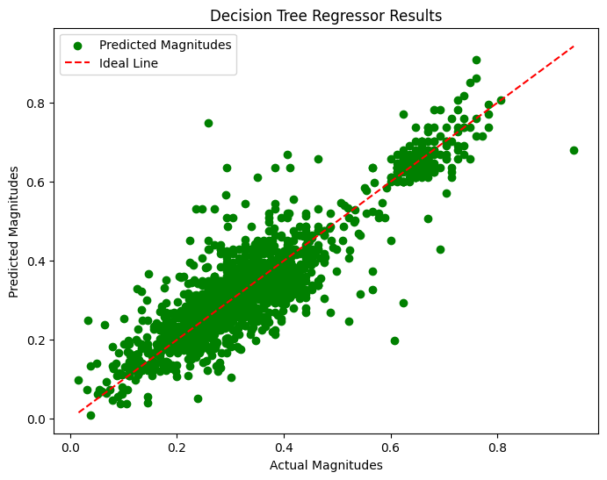
Model Training:
Split the earthquake dataset into training and testing sets.
Initialize the Decision Tree regressor and fit it to the training data.
Predictions:
The regressor recursively splits the data based on features to minimize mean squared error during training.
The training data included features such as latitude, longitude, depth, and other relevant attributes.
Evaluation Metrics: After training, make predictions on the test data using the learned decision rules in the tree structure.
Mean Squared Error (MSE): The Decision Tree Regressor achieved an MSE of approximately 0.00376, indicating a relatively low average squared difference between actual and predicted earthquake magnitudes.
R-squared (Accuracy): The Decision Tree Regressor achieved an R-squared value of about 0.8028, indicating that approximately 80.28% of the variance in earthquake magnitudes is predictable from the independent variables.

Slide 29
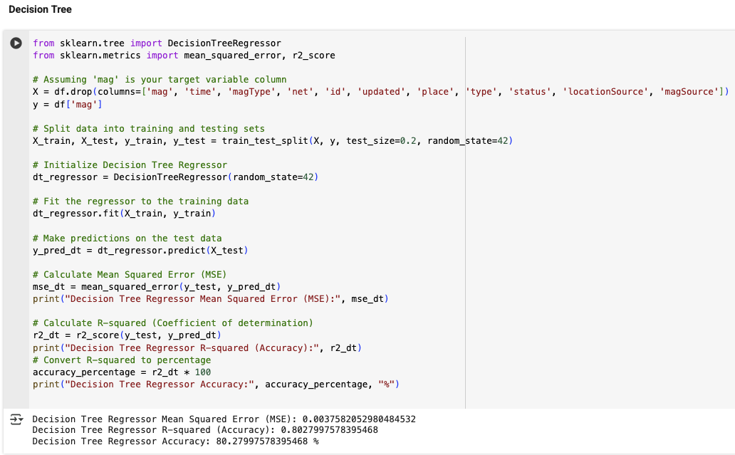

Slide 30
Model Comparison and Selection
Dataset Size: If the earthquake dataset is relatively small and computational resources are not a limitation, the KNN Regressor's higher accuracy (R-squared) may make it a preferred choice due to its ability to capture intricate patterns in the data
Complexity and Interpretability: If interpretability and understanding of decision rules are crucial, the Decision Tree Regressor's visual nature and clear decision boundaries make it a suitable option.Further Experimentation: Conducting further experimentation, such as fine-tuning hyperparameters or exploring ensemble methods like Random Forest, Gradient Boosting, or XGBoost, can provide insights into improving model performance and generalization.
In conclusion, both K-Nearest Neighbors (KNN) Regression and Decision Tree Regression models offer strengths and limitations in predicting earthquake magnitudes. The choice between these models depends on factors such as dataset size, computational resources, interpretability requirements, and the need for generalization to unseen data. Thorough experimentation, evaluation of performance metrics, and consideration of project-specific requirements are essential for selecting the most suitable model for earthquake magnitude prediction.

Slide 31
Interpretation
Mean Squared Error (MSE):
The Mean Squared Error (MSE) measures the average squared difference between the actual earthquake magnitudes and the predicted magnitudes by the model.
Lower MSE values indicate that the model's predictions are closer to the actual values, reflecting better accuracy and performance.
In this case, the KNN Regression model has a lower MSE (0.00289) compared to the Decision Tree Regression model (0.00376), suggesting that the KNN model's predictions are more accurate on average.
R-squared (Coefficient of Determination)
The R-squared value (accuracy) represents the proportion of variance in the dependent variable (earthquake magnitudes) that is predictable from the independent variables (features) in the dataset.
Higher R-squared values indicate that the model can explain a larger proportion of the variance in the target variable.
The KNN Regression model achieved an R-squared value of approximately 0.8483 (84.83%), indicating that about 84.83% of the variance in earthquake magnitudes can be explained by the features used in the model.
Similarly, the Decision Tree Regression model achieved an R-squared value of approximately 0.8028 (80.28%), indicating that about 80.28% of the variance in earthquake magnitudes can be explained.

Slide 32
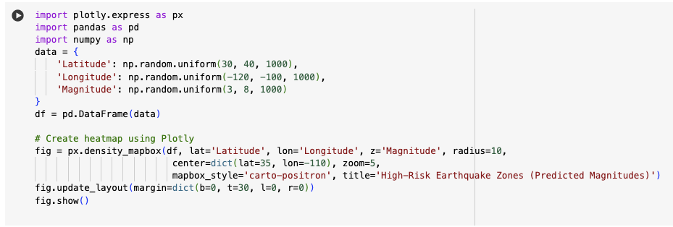

Slide 33
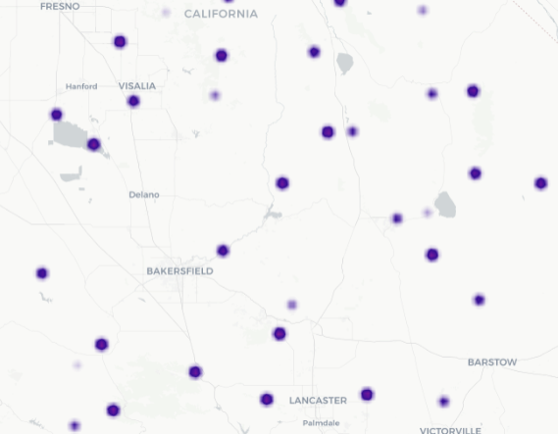
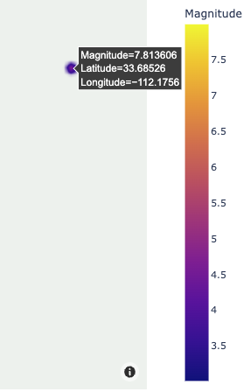
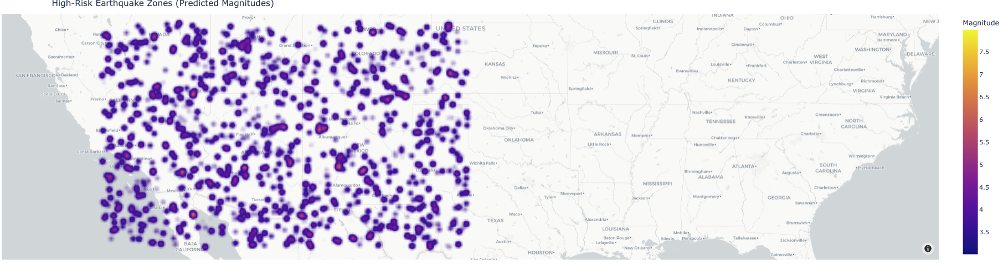
Practical Implication: Accurate earthquake prediction models contribute significantly to enhancing early warning systems. By leveraging machine learning algorithms, authorities can receive timely alerts and take proactive measures to mitigate risks and ensure public safety.
Recommendation: Implement real-time monitoring systems that integrate predictive models. Visualizations such as time-series plots showing predicted earthquake magnitudes against actual occurrences can aid in decision-making during critical moments.

Slide 34
Planned Deployment
Real-time monitoring integration
Heatmap visualizations for high-risk zones
Enhancement of early warning systems by providing actionable predictions
Continuous Improvement: Recommending continuous model improvement through data updates, algorithm refinements, and collaboration with domain experts to enhance the accuracy and reliability of earthquake prediction models.
Practical Implications: Highlighting the practical implications of accurate earthquake predictions for early warning systems, disaster response planning, and infrastructure resilience. Emphasizing the importance of actionable recommendations based on the analysis and findings.

Slide 35
Conclusion and Future Work
Conclusion: Our earthquake prediction project aims to demonstrate the potential of machine learning techniques in forecasting seismic events. By following the CRISP-DM methodology, we plan to systematically move from understanding the business need to deploying predictive insights. We intend to experiment with models such as K-Nearest Neighbors (KNN) and Decision Trees, with the goal of achieving high predictive accuracy. This project will emphasize the importance of clean data preparation, thoughtful model selection, and continuous model improvement. Upon successful completion, the predictive models developed can be integrated into early warning systems, helping to save lives, reduce infrastructure damage, and enhance disaster preparedness efforts globally.
Future Work
Hyper Parameter Tuning Model Deployment in Cloud/POC on Streamlit Use the latest surveyed data Use the other supported datasets Implement advanced clustering algorithms

Slide 36
References
Earthquake Magnitude Prediction Using Machine Learning Techniques​ (This study employs various machine learning algorithms, including Decision Tree and KNN, to predict earthquake magnitudes using the USGS dataset. It emphasizes data preprocessing steps like handling missing values and feature scaling.​ )
https://www.researchgate.net/publication/380073427_Earthquake_Magnitude_Prediction_Using_Machine_Learning_Techniques
Improving Earthquake Prediction Accuracy in Los Angeles with Machine Learning​ (This paper explores the application of advanced machine learning models, particularly Random Forest, to enhance earthquake prediction accuracy in Los Angeles, demonstrating significant improvements over traditional methods.)
https://pubmed.ncbi.nlm.nih.gov/39424892/
Implementation of Machine Learning Algorithms for Seismic Events Classification (The study applies various machine learning classifiers, including KNN and Decision Trees, to categorize seismic events, achieving high accuracy and demonstrating the potential of ML in seismic data analysis.)
https://arxiv.org/abs/2502.05197
Predicting the Likelihood of an Earthquake by Leveraging Machine Learning (This research utilizes machine learning to predict earthquake occurrences, focusing on features like geographical coordinates, magnitudes, and depths, aligning well with your project's feature set.)
https://www.espublisher.com/uploads/article_html/engineered-science/10.30919-es1031.htm
Analysis and Prediction of Earthquakes Using Different Machine Learning Techniques (The paper analyzes real-world earthquake data to predict magnitudes and depths using models like Random Forest and Polynomial Regression, providing insights into model performance comparisons.)
https://essay.utwente.nl/87313/1/Mondol_BA_EEMCS.pdf

